Slide 1
COMP 3500 Introduction to Operating Systems Project 4 – Processes and System Calls Part 4: Managing Process State
Dr. Xiao Qin
Auburn University http://www.eng.auburn.edu/~xqin
xqin@auburn.edu
Notes:
Fall’17
Lec28: Slides 1-25: 35 Minutes
Lec29: Slides 1-10: 15 Mintues
Spring’17: 40 Minutes slides 1-19.
Fall’16:
50 Minutes: slides 1-19
Fall’15:
Fall’14: Slides 14-16 in Project 4-4-Managing file system state: 15 min
Slides 1-14: 45 Minutes.
Next lecture: 15-27: 40 min

Slide 2
System Calls Related to Process Management at the User Level
Exercise 1 (Plickers): Where can you find the following prototypes?
int execv(const char *prog, char *const *args);
pid_t fork(void);
int waitpid(pid_t pid, int *returncode, int flags);
__DEAD void _exit(int code);
A. ~/cs161/src/include/syscall.h
B. ~/cs161/src/include/unistd.h
C. ~/cs161/src/kern/include/syscall.h
D. ~/cs161/src/kern/include/unistd.h
Notes:
Reference: https://en.wikipedia.org/wiki/Unistd.h
In the C and C++ programming languages, unistd.h is the name of the header file that provides access to the POSIX operating system API. It is defined by the POSIX.1 standard, the base of the Single Unix Specification, and should therefore be available in any conforming (or quasi-conforming) operating system/compiler (all official versions of UNIX, including Mac OS X, Linux, etc.).

Slide 3
System Calls Interface
A. ~/cs161/src/include/syscall.h
B. ~/cs161/src/include/unistd.h
C. ~/cs161/src/kern/include/syscall.h
D. ~/cs161/src/kern/include/unistd.h
Exercise 2 (Plickers): Where can you find the sys_fork() prototype?
Notes:
Question 1:
Where can you find the prototype of open(filename, flags, …)?
Answer: ~/cs161/src/include/unistd.h
Question 2:
Where do you declare the prototype of sys_open(filename, flags, …)?
Answer: ~/cs161/src/kern/include/syscall.h

Slide 4
Exercise 3 (Plickers, Wheeldecide) Design Question 1: What is your decision? Why? A. Single-threaded B. Multiple-threaded processes
We only consider single threaded processes.
Each process has only one thread
What does this design decision imply?
Important: No need to create process structure.
Notes:
Not the data structure to store and organize data in files
Let’s focus on meta data of files

Slide 5
Exercise 4 (Wheeldecide) Data Structure Question 1: What fields should be added in the thread struct? (Hints: two items)
Add two new fields in the thread struct:
pid: process ID
openfileTable (see also slides of Project 4: Part 4)
Notes:
a file descriptor (FD) is an abstract indicator for accessing a file.

Slide 6
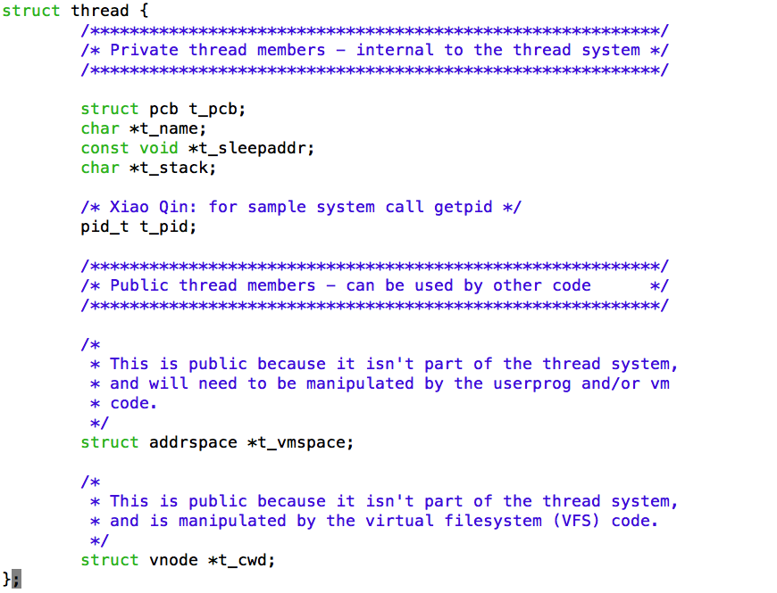
What fields should be added in the thread struct?
Notes:
t_pid, t means thread
pid_t, t means data type.
Add 1. pid 2. openfileTable

Slide 7
Process Identifier
PID or Process ID: process identifier
Temporarily uniquely identify a process
PID is used as a parameter in various function calls
allowing processes to be manipulated
Sample function calls that use PID:
Adjust a process's priority
kill a process
Notes:
Social security number.

Slide 8
Process Identifier (cont.)
When a thread is create, PID is returned to its parent who refers to this child in further function calls.
For example:
int
pid_wait(pid_t theirpid, int *status, int flags, pid_t *ret)
A parent waits for its child to terminate with the following function
Notes:
Social security number.

Slide 9
Exercise 5 (Wheeldecide) Design Question 2: How to allocate (i.e., assign) PIDs? Please offer a basic idea.
Assign PID sequentially
Looping back to PIN_MIN when we reach PIN_MAX
Do not reuse the same PID quickly (no identical PIDs within a few minutes)

Slide 10
Process ID Management Module
Manage PID information (What is this?)
Implement your PID management functions here:
src/kern/thread/pid.c
Notes:
Think about social security numbers.
Managed by social security administration.

Slide 11
Data Structure Question 2: Process ID Management What is PID information or pidinfo? (see functions on slide 14)
Process id of the thread
Process id of its parent thread
Is it exited? True if it has exited
exitstatus (see Algorithm 2 on slide 19)
A condition variable: use to implement waitpid(), i.e., wait for thread exit
Notes:
Think about social security numbers.
Managed by social security administration.

Slide 12
Data Structure Question 3: What are global variables for PID management?
nextpid: Next candidate (i.e., available) PID Note: similar to PC – program counter.
Number of allocated PIDs
For a static PID table
Pidlock: A global lock for PID management
Exercise 6 (Wheeldecide): Why we need a lock here?

Slide 13
Data Structure Question 4: What is the data structure for all pidinfo variables?
pidinfoTable: a table of pidinfo
Static Array
A global variable
Size of the table: MAX_PROCS

Slide 14
Process ID Management: Suggested Functions (see pidinfo on slide 11)
Initialization
Create and Destroy pidinfo
Given pid, retrieve pidinfo from pidinfoTable
Add a new pidinfo into the pidinfoTable
PID Allocation and Unallocation
Wait for PID (see also waitpid system call)
Set exitstatus of pidinfo

Slide 15
Algorithm 1: How to allocate a PID? int pid_allocate(pid_t *retPID)
Lock pidlock;
Check: number of existing processes < MAX_PROCS
pidinfo_index = get_pidinfo_index(nextpid);
while (pidinfoTable[pidinfo_index] !available) {
increase nextpid;
pidinfo_index = get_pidinfo_index(nextpid);
}
pid = nextpid;
Increase nextpid;
new_pidinfo = create_pidinfo(pid, parent pid);
Add new_pidinfo into pidinfoTable;
Unlock pidlock;
Return pid;
Notes:
int get_pidinfo_index(nextpid) {
return(nextpid % MAX_PROCS);
}
Parent PID is current->pid

Slide 16
How to Implement system call waitpid?
Userland:
int waitpid(pid_t pid, int *returncode, int flags);
Manual page: waitpid.html
Wait for the process specified by pid to exit
Return its exit code in the integer pointed to by returncode.
If that process has exited already, waitpid returns immediately. If that process does not exist, waitpid fails.
Notes:
int get_pidinfo_index(nextpid) {
return(nextpid % MAX_PROCS);
}
Parent PID is current->pid

Slide 17
How to Implement system call sys_waitpid?
In Userland:
int waitpid(pid_t pid, int *returncode, int flags);
Two Implementation Strategies:
Strategy 2 is recommended. Why?
Implement this syscall in
Strategy 1: sys_waitpid()does everything
OR
Strategy 2: Let sys_waitpid() pass information to pid_wait() to do all the work.
Notes:
int get_pidinfo_index(nextpid) {
return(nextpid % MAX_PROCS);
}
Parent PID is current->pid
Strategy 2 is recommended. Why? sys_waitpid() is the interface between system call hander (mips_syscall()) and pid_wait().

Slide 18
How to implement system call pid_wait()?
In Kernel:
int
pid_wait(pid_t wpid, int *status, int flags, pid_t *ret)
This is a synchronization problem: use condition variable
A parent waits for its child
Notes:
int get_pidinfo_index(nextpid) {
return(nextpid % MAX_PROCS);
}
Parent PID is current->pid

Slide 19
Algorithm 2: pid_wait(pid_t wpid, int *status, int flags, pid_t *ret)
If (wait for itself) return EINVAL;
Lock pidlock; /* Why 1? */
wpidinfo = get_pidinfo(wpid);
If (wpidinfo’s parent pid != curthread->t_pid) /* Why 2? */
Unlock pidlock; return EPERM;
If (wpidinfo’s exited == false) {/* child is active */
if (flags == WNOHANG) { /* Optional */
Unlock pidlock; *ret = 0; return 0;
}
/* Whose pi_cv should we use? */
cv_wait(wpidinfo->pi_cv, pidlock);
}
*status = wpidinfo->exitstatus;
*ret = wpid;
Set wpidinfo’s parent pid to 0;
Remove wpidinfo from pidinfoTable;
Unlock pidlock;
Notes:
Why 1: support condition variable (wpidinfo->pi_cv) – a shared resource.
Why 2: child must wait for parent.
Note: you may support flags like WNOHANG (it is optional)
If (wpidinfo’s exited == false) /* child is active */
cv_wait(wpidinfo->pi_cv, pidlock);

Slide 20
How to Implement system call _exit?
Userland: void _exit(int code);
Implement this syscall in
Strategy 1: sys_exit()does everything
OR
Strategy 2: Let sys_exit() calls thread_exit(), which does all the work.
Modify the existing thread_exit() function
Notes:
int get_pidinfo_index(nextpid) {
return(nextpid % MAX_PROCS);
}
Parent PID is current->pid

Slide 21
Algorithm 3: thread_exit(int exitcode)
Set the exitstatus of curthread to exitcode;
/* Existing source code */
Call as_destroy() to remove curthread’s address space;
Decrease cwd reference;
/* You need to add the following code */
Destroy curthread’s filetable;
Notes:
Note: Modify thread_exit

Slide 22
What is system call fork?
It enables multiprogramming
Create a copy of a calling process
Parent and child processes each observe return values
Notes:
int get_pidinfo_index(nextpid) {
return(nextpid % MAX_PROCS);
}
Parent PID is current->pid

Slide 23
How to implement system call fork?
Userland: pid_t fork(void);
sys_fork() calls thread_fork(), which has been partially implemented in kern/thread/thread.c
Step 1: Implement the sys_fork() function
Step 2: Modify the thread_fork() function
Notes:
int get_pidinfo_index(nextpid) {
return(nextpid % MAX_PROCS);
}
Parent PID is current->pid

Slide 24
Step 1: How to implement sys_fork()?
sys_fork() takes care of the trapframe handling.
Copy the trapframe prior to calling thread_fork()
Then, it calls the thread_fork() to deal with the rest of the work.
Notes:
int get_pidinfo_index(nextpid) {
return(nextpid % MAX_PROCS);
}
Parent PID is current->pid

Slide 25
Algorithm 4: int sys_fork(struct trapframe *tf, pid_t *retval)
Create a new trap_frame called new_tf;
Copy tf to new_tf;
/* Call thread_fork( ) */
result = thread_fork(curthread->t_name, ntf, 0, child_thread, retval);)
if (result != 0) { /* failed in thread_fork */
delete new_tf;
return result;
}
return 0;
Notes:
Note: Modify thread_exit
Sys_fork() works on trap frame and deal with error code.

Slide 26
Algorithm 5: how to modify int thread_fork(const char *name, void *data1, unsigned long data2, void (*func)(void *, unsigned long), pid_t *childpid)
/* newguy is a new thread */
Allocate new_pid for newguy;
Set newguy->t_pid = new_pid;
Copy curthread’s fileTable to newguy;
/* Call as_copy() */
copy curthread’s vmspace to newguy;
Set *childpid to newguy’s t_pid
Notes:
Note: Modify thread_fork
Old prototype:
New prototype:
int thread_fork(const char *name, void *data1, unsigned long data2, void (*func)(void *, unsigned long), pid_t *childpid /* new for project 4 */))

Slide 27
How to implement system call exec?
sys_execv(): Implement it here src/kern/userprog/runprogram.c
Use runprogram() as a template
Feel free to modify runprogram()
Important Part: Argument handling

Slide 28
How to implement sys_exec()?
Step 1: copyin the program name
Step 2: copyin_args the argv
Step 3: load the executable
Step 4: copyout_args the argv
Step 5: warp to usermode

Slide 29
Local Variblies used in sys_exec()
int
sys_execv(userptr_t prog, userptr_t argv)
{
char *path;
int argc;
vaddr_t entrypoint, stackptr;
int result;
......
userptr_t defined in src/kern/include/types.h
Notes:
userptr_t is a pointer to a one-byte struct

Slide 30
Details of sys_exec()
get the filename from prog
allocate the space to argdata.buffer
do the copyin from argv to argdata.buffer
load the executable
send the argv strings to the process.
free the argdata space
/* warp to user mode. */
md_usermode(argc, argv, stackptr, entrypoint);
Notes:
userptr_t is a pointer to a one-byte struct

